Slide 1
Thinking About an Entrepreneurial Career or a Career Generally
Eric Furfine

Slide 2
Today’s Speakers
John Normann is the VP of Technology at Iora Health. He went from completing his PhD in English at Harvard Unviersity to being a tech founder, while having taught Renaissance literature, engineering, and media studies.
Asa Kalavade is General Manager at Amazon Web Services. She completed her PhD in Electrical Engineering and Computer Science at Berkeley and went on to found two successful ventures and hold senior roles in the analytics and mobile technologies sector.
Eyal Ron is CTO at Gelesis and Adjunct Faculty at the Harvard-MIT Division of Health and Sciences and Technology. He is a proud Brandeis alum, holding a PhD in Chemistry and has successfully used his knowledge both in academia and the startup world.
Vipin Suri is VP of Discovery at Obsidian Therapeutics. Vipin obtained his Ph.D. in biochemistry at Brandeis University and MBA from Yale School of Management. He uses both his academic and business experience to contribute to broadening the reach of Cell and Gene therapies.

Slide 3
Disclaimer
Everything I offer today is how I see my own decision making processes on career progression and work efforts
I’m sure this strategy is not right for everyone
I think many of the themes are; however, broadly applicable and worth some consideration

Slide 4
You Don’t Necessarily Need to Start Out With an Explicit Goal to be an Entrepreneur
It is something you can grow into
If you are curious, you may end up there
OK to learn the ropes of a field an a large company with many experienced line managers
It is also fine to jump straight in and try to wear all the hats necessary rather then picking up the pieces over time then going for it
Smaller companies can be more fun for some people in the right mindset

Slide 5
Try New Things: If You Were Not Attracted to Continual Learning, You would Not be a Scientist
If we knew the answer or outcome, it would not be called research (Einstein, I think)
Every time I have taken a new job, it has been to stretch my skills and learning
  Usually also entails an ability to more broadly influence corporate direction
  This happens as a result of gaining skills in previous jobs
Keep one foot in the box for stability
But take one foot out so you can grow
I find it often takes about 3 years to get your stability and competency up
  Year One is usually a steep curve
  Get your sea legs year two and start looking forward instead of reacting
  Year three you can really drive strategy

Slide 6
Career Progression: USE YOUR NETWORK
AB in Chemistry Washington University, St Louis, 1981
Ph.D. Biochemistry, Brandeis University, Robert Abeles Advisor, Enzymology, 1987
Postdoctoral Study, UCSF, C.C. Wang, Molecular Parasitology, 1989
Scientist, Burroughs Wellcome, 1995
Principal/Senior Scientist, Project Leader, Glaxo Wellcome, 2000
Director Multidisciplinary Drug Discovery GSK, 2002
VP Preclinical Development Regeneron 2006
SVP Research and Preclinical Development, Adnexus/BMS 2011
Chief Scientific Officer Eleven Biotherapeutics 2016
CSO and CEO ImmuneXcite Inc, present

Slide 7
Three Achievements of Which I am Most Proud Have Aspects of Entrepreneurship
Inventor of Lexiva® (fosamprenavir)
  Dramatically reduced pill burden of a HIV protease inhibitor
Provided the initial rationale for the clinical strategy that made Eylea the success that it is today
  Treats age-related macular degeneration
  At least equal efficacy with less frequent ocular injections
Discovered EBI-031 (anti-IL-6 with long ocular half-life) with potential to treat ocular inflammation
  Able to sell to Roche for $30M upfront, which allowed Eleven Biotherapeutics to re-invent itself and stay a publicly traded company after two failed phase 3 trials with a different drug
  New company has a phase 3 asset in oncology that was purchased with the new funds

Slide 8
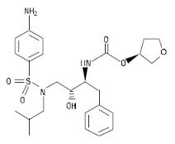
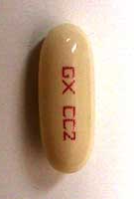
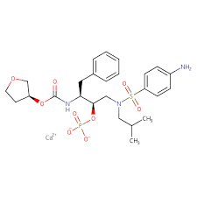

Agenerase vs Lexiva (each 2X per day)
VS.

Slide 9
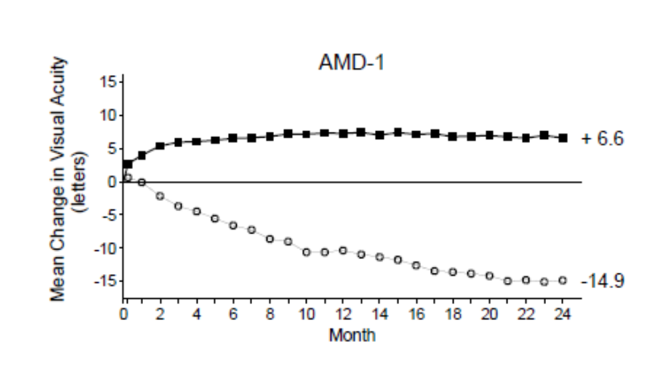
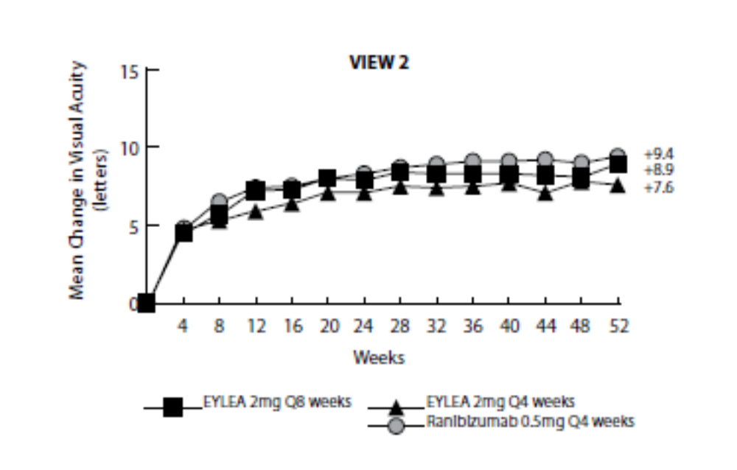
Eylea® vs Lucentis® (both VEGF Blockers)
Lucentis/Ranibizumab approval data
Eylea approval data

Slide 10
Some Keys to Career Development as an Entrepreneur or Not

Slide 11
What Skills Got You Here May, Probably, Will Not Get You There
To progress your career you have to advance your skills
Your ability to communicate, write and present, coherently will become more and more important as your career progresses and is MOST critical to an entrepreneur
  Some have natural or already learned abilities in this regard
  I did not, it was a lot of work but worth it.
  For writing, consider reading “Elements of Style” by Strunk and White
  The mindset and skills from the book will also help with presentations because creating slides utilizes many of the same skills (but not all)
Take courses/classes on presenting skills and slide preparation
People skills are exponentially more important as you advance your career, especially into leadership (better word than management) positions

Slide 12
What is Often the Key to Advancing?
The degree of strategic thinking increases
People can be very good at what they do
They can be expert at solving the problems that they are presented with, often/commonly by their managers
What it takes to get to “the next level” is the ability to foresee what questions need answering and what problems need solving, rather than being able to answer a question/challenge or solve the problem

Slide 13
What is the One Thing That Gets in the Way of Most (All?) of Our Advancing (as Humans Even)?
A sense of security and confidence
Our insecurity constantly impedes our ability to be the best we can be and make the most contributions to society
Insecurity can express itself antithetically in different people
Some extreme examples, just to make a point
Bullies are always trying to prove themselves by trying to dominate because the are afraid they are missing something or don’t really deserve to be where they are
Quiet types never speak up because they are afraid of being wrong or thought to be wrong or “stupid”

Slide 14
Some Lessons I Learned as a Leader/Manager
Push decision making as far down in the organization as possible
  You are still responsible ultimately
  But let the people closer to the data and science make the decisions
  The KEY: make sure they consider all relevant aspects before they make the decision – provide context and perspective
Be as just as critical (or more) of results that fit your hypothesis than ones that do not fit
  We often try and find something wrong with data that does not fit our theory
  We are often very accepting of data that does fit our theory
  We make a lot of mistakes thinking that way
Who is your audience????
  Make sure everyone is at the same starting place as best as possible
  The amount of detail and background will vary

